Slide 1

Sensorless Maximum Power Point Tracking in Multi-Type Wind Energy Conversion Systems
Presenter: Lingling Fan
University of South Florida
Tampa, FL 33620
USA

Slide 2
Outline
Objectives
Two types of WECS
  DFIG (doubly-fed induction generator) connected with the grid
  PMSG (permanent magnet synchronous generator) serving a load
MPPT principles
  With/wo anemometer
Case studies
Conclusion

Slide 3
Objective
  Maximum power point tracking (MPPT) of wind energy conversion systems (WECS) without anemometer to measure wind speed
Existing research
  MPPT with anemometer or wind speed estimation
    Control Rotor speed
  MPPT without anemometer
    Control torque or power

Slide 4
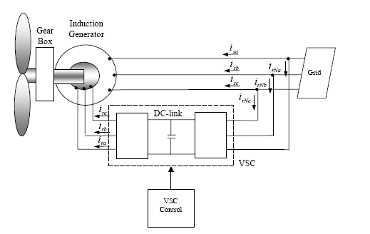
Types of WECS - DFIG
Ps
f_{m}
RSC
AC/DC
GSC
DC/AC
Pr = sPs

Slide 5
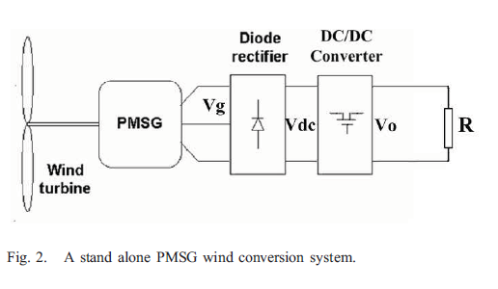
Types of WECS - PMSG

Slide 6
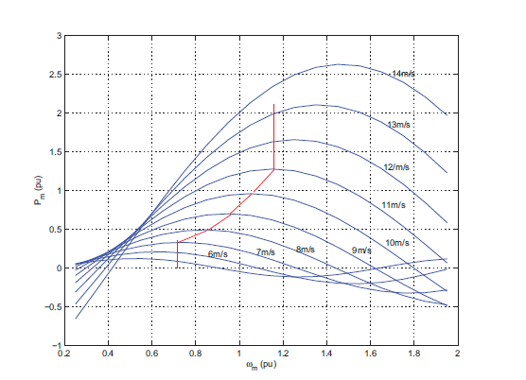
MPPT principle
Consumed electric power should equal to the wind power generated
Maximum wind power harvested:

Slide 7
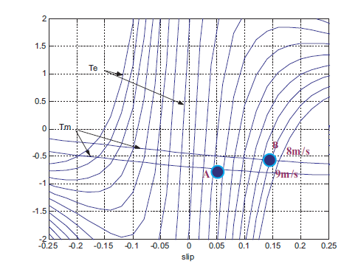
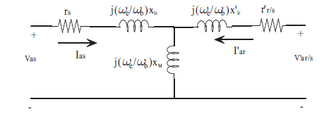
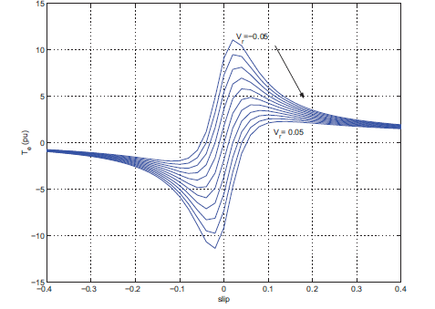
MPPT for DFIG
Changing injected voltage from the rotor side converter (RSC) can move the operating point for MPPT!

Slide 8
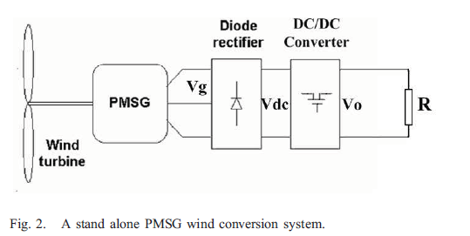





MPPT for PMSG

Slide 9
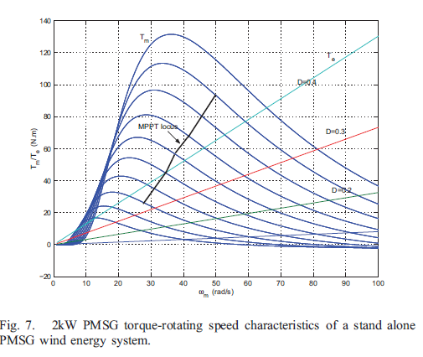
MPPT - PMSG
Changing the duty cycle of the dc-dc booster D can move the operating point for MPPT!

Slide 10
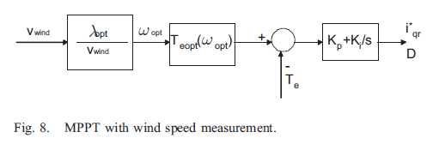
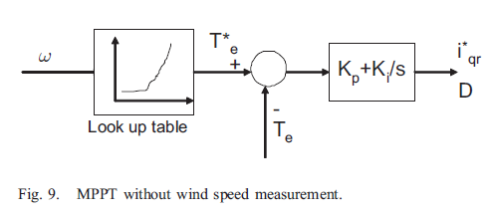
Feedback control for MPPT

Slide 11
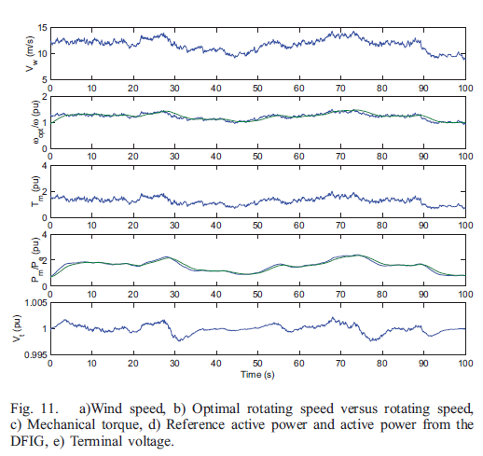
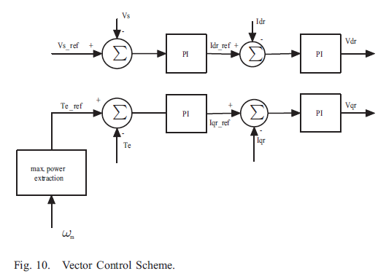
Case Studies
A grid-tied DFIG

Slide 12
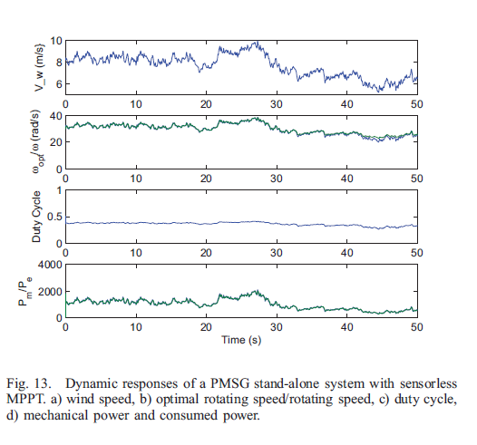
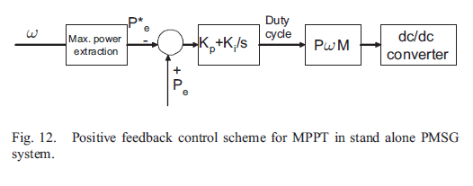
Case Studies
A PMSG stand-alone system

Slide 13
Conclusion
A frame work of sensorless MPPT is built
Applications discussed
  A grid-tied DFIG system
  A stand alone PMSG system

